Slide 1
Bank Loan Stats
March 2022 Update

Slide 2
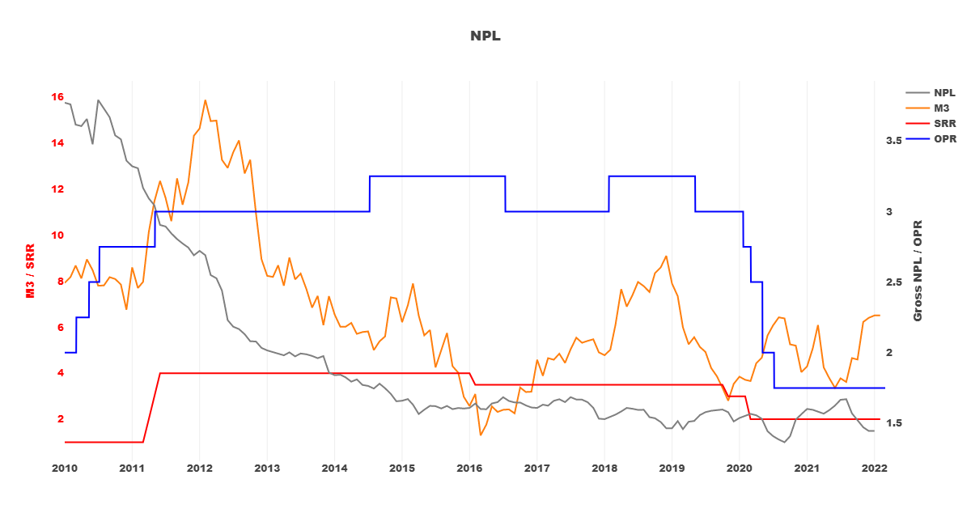
Overview of Bank Loan Stats
M3 is higher YoY; while Non-performing Loan (NPL) is lower YoY.

Slide 3
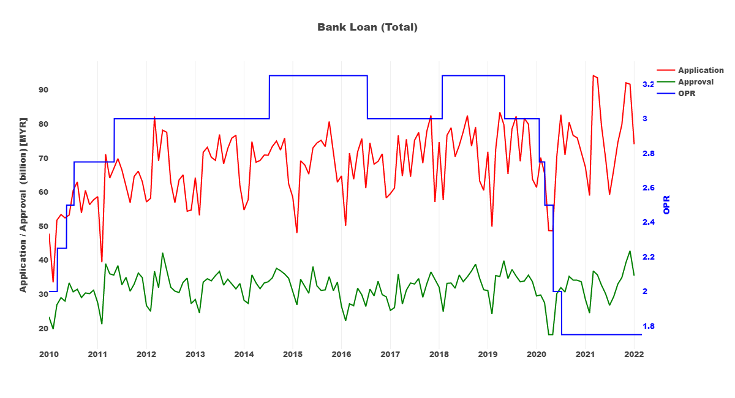
Total Bank Loan Application and Approval
Total bank loan application and approval amounts have improved YoY as of Jan 2022.

Slide 4
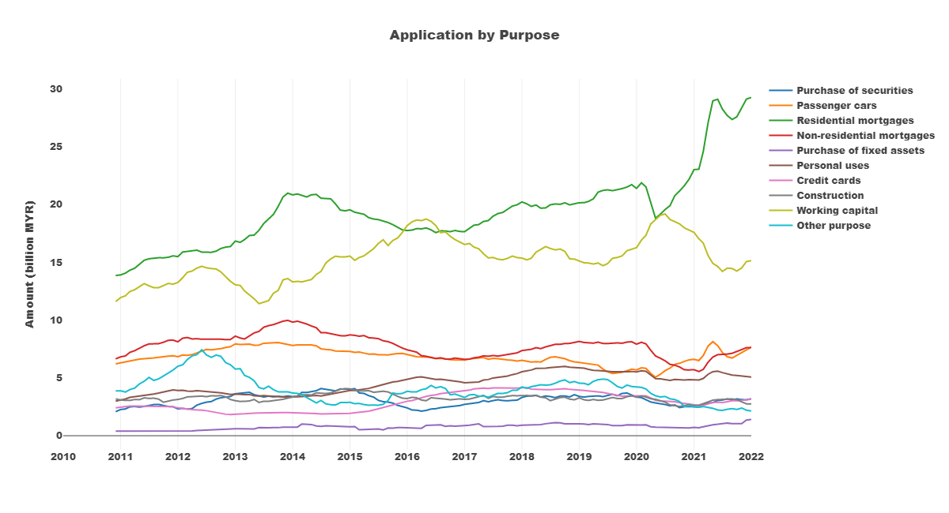
Loan Application by Purpose (Rolling 12 Months Average)

Slide 5
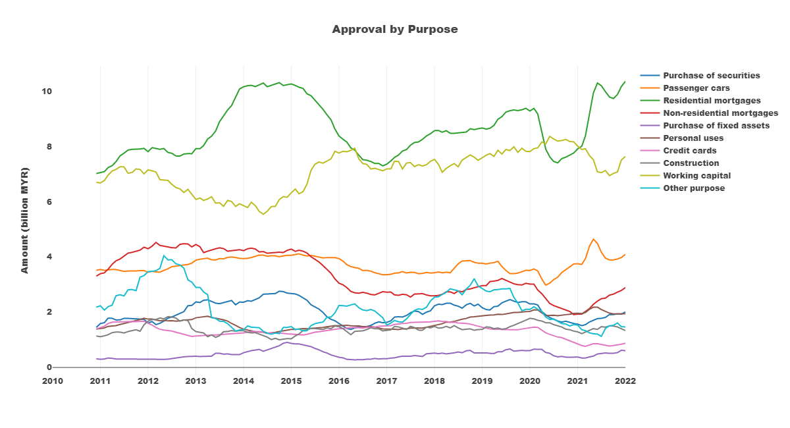
Loan Approval by Purpose (Rolling 12 Months Average)

Slide 6
YoY% Change in Loan Application and Approval
Loan Application | 2021Oct-YoY | 2021Nov-YoY | 2021Dec-YoY | 2022Jan-YoY |  | Loan Approval | 2021Oct-YoY | 2021Nov-YoY | 2021Dec-YoY | 2022Jan-YoY
Purchase of fixed assets | -17.03 | 16.81 | 577.04 | 66.79 |  | Purchase of securities | -0.32 | 16.91 | -8.67 | 72.28
Passenger cars | 36.7 | 32.77 | 32.9 | 47.56 |  | Credit cards | 23.88 | 23.66 | 36.57 | 63.53
Purchase of securities | 25.3 | -18.1 | -6.46 | 36.87 |  | Non-residential mortgages | 18.31 | 39.05 | 31.62 | 51.69
Credit cards | 3.46 | 8.6 | 17.46 | 29.7 |  | Passenger cars | 0.21 | 7.53 | 14.59 | 33.94
Working capital | -16.68 | 22.35 | 56.74 | 8.08 |  | Working capital | 12.75 | 8.25 | 66.41 | 30.49
Residential mortgages | 9.74 | 36.09 | 33.79 | 6.45 |  | Residential mortgages | -6.06 | 16.66 | 37.85 | 25.27
Construction | -24.4 | -50.83 | -47.45 | 2.77 |  | Personal uses | -14.1 | 1.1 | -0.43 | 3.13
Non-residential mortgages | 24.18 | 33.56 | 29.82 | 1.3 |  | Other purpose | 18.74 | 74.05 | -61.7 | -7.24
Personal uses | -6.43 | -6.31 | -9.64 | -13.17 |  | Purchase of fixed assets | -0.95 | 87.79 | 250.57 | -38.01
Other purpose | -50.32 | 104.54 | -73.7 | -37.41 |  | Construction | -4.81 | -21.25 | -48.35 | -38.93
Loan Application and Approval for credit cards, passenger cars, and residential mortgages have increased consistently and significantly YoY for 2021 Oct to 2022 Jan.

Slide 7
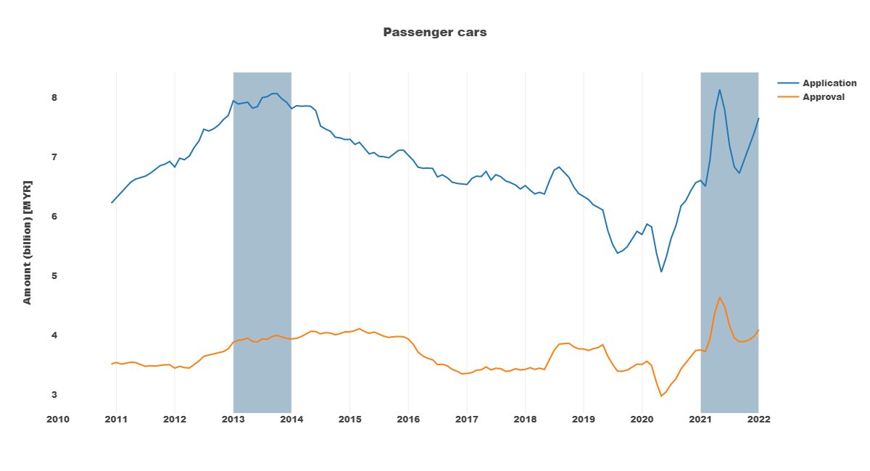
Passenger Car Loans
Both loan application and approval is on a rising trend since 2020 March.
Both amounts are near the peaks of 2013/14.

Slide 8
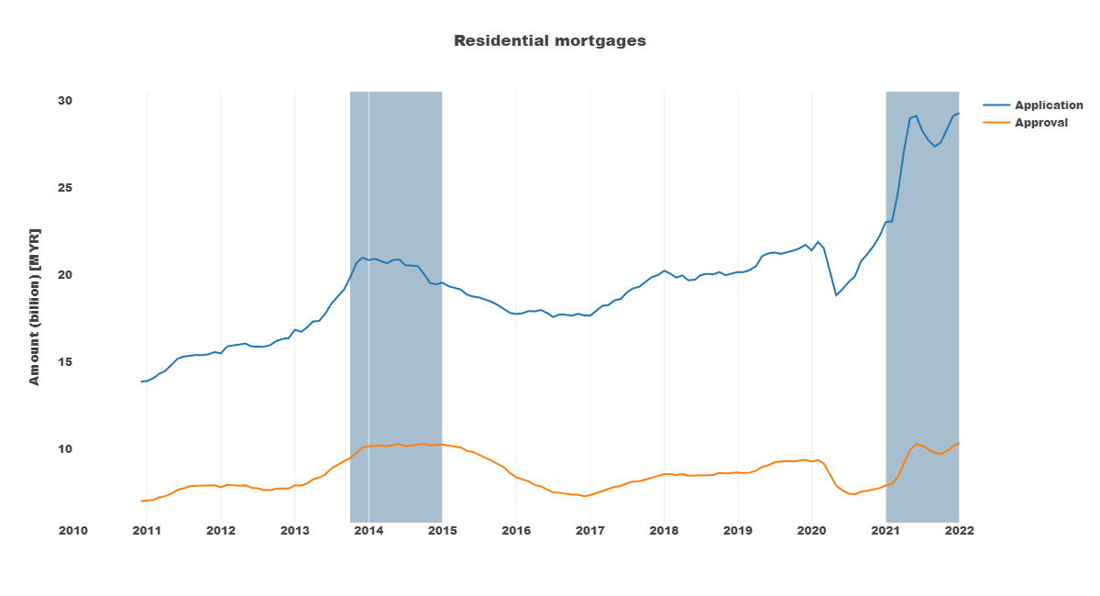
Residential Mortgages
Both loan application and approval amounts are above/near the peak of 2014 and on a rising trend.

Slide 9
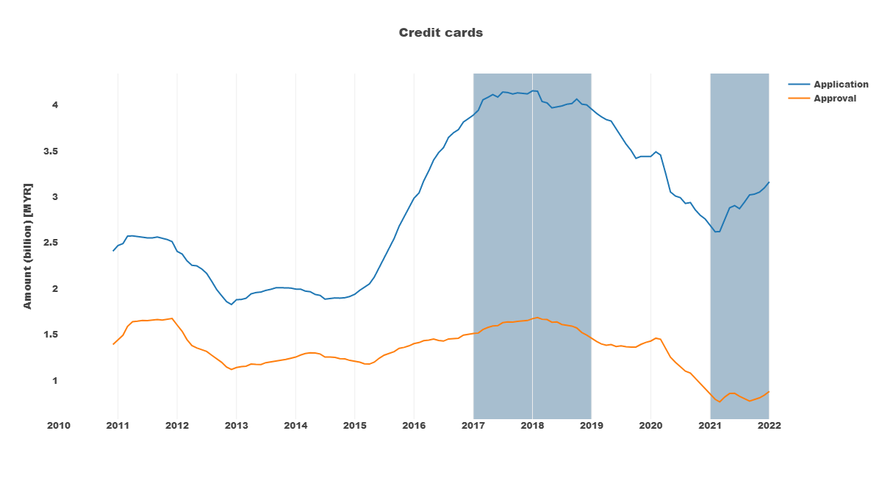
Credit Cards
Credit cards loan stat is a good indicator of consumer sentiment.
The latest trend for application and approval rebounded from the lows in early 2021, and are currently on the rise.

